Slide 1

Insights on IPL for Sports Magazine
Presented by: Diksha Singh

Slide 2
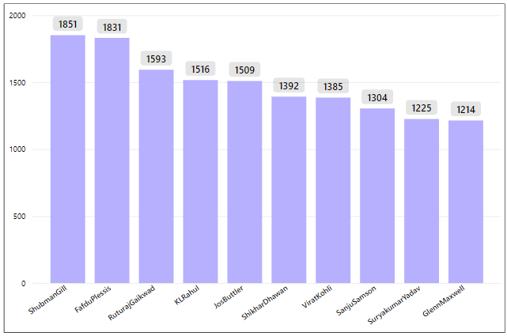
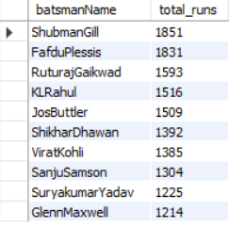
Ques 1. Top 10 batsmen based on past 3 years total runs scored?

Slide 3
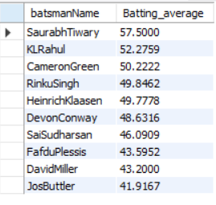
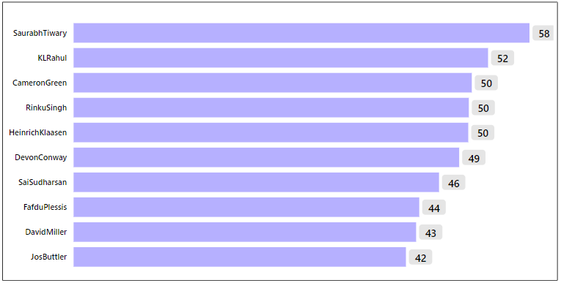
Ques 2. Top 10 batsmen based on past 3 years batting average?

Slide 4
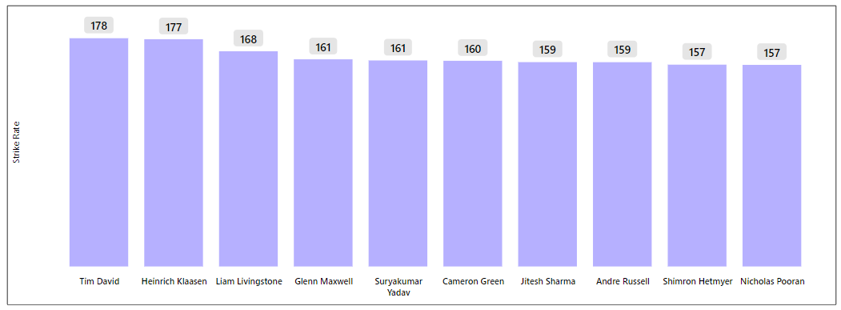
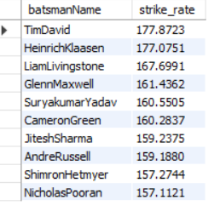
Ques.3 Top 10 batsmen based on past 3 years strike rate?

Slide 5
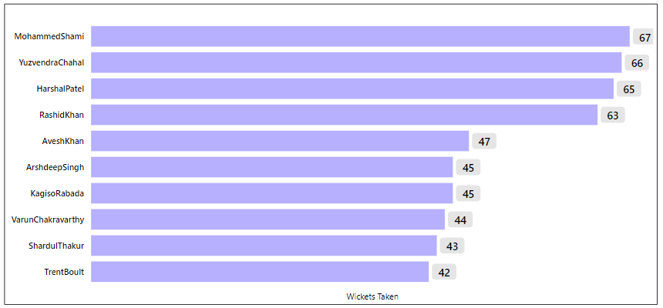
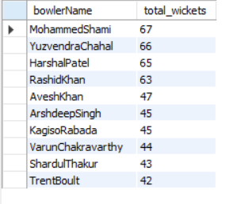
Ques.4 Top 10 bowlers based on past 3 years total wickets taken?

Slide 6
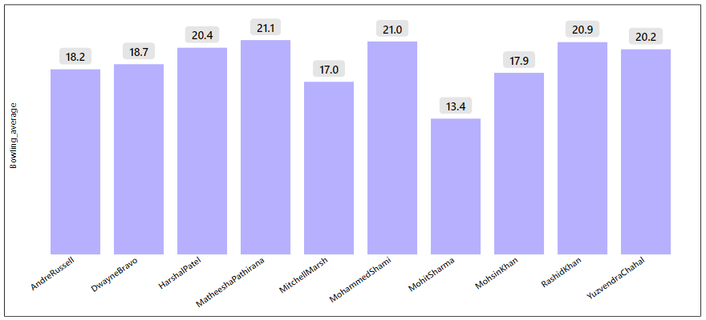
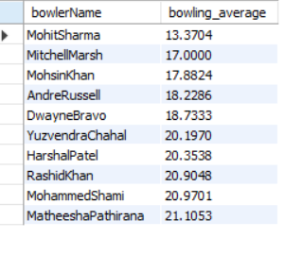
Ques.5 Top 10 bowlers based on past 3 years bowling average?

Slide 7
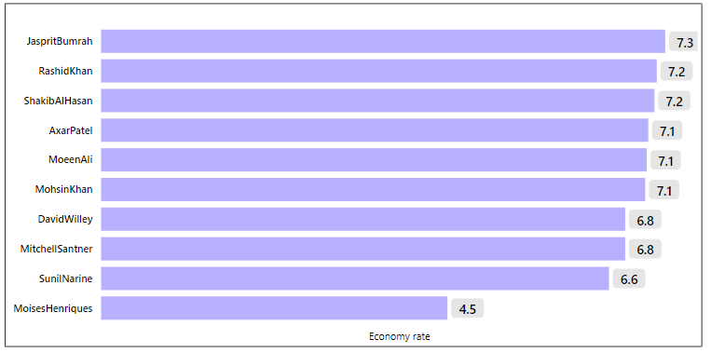
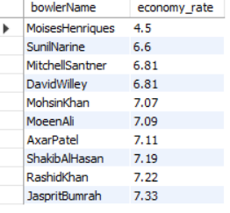
Ques.6 Top 10 bowlers based on past 3 years economy rate?

Slide 8
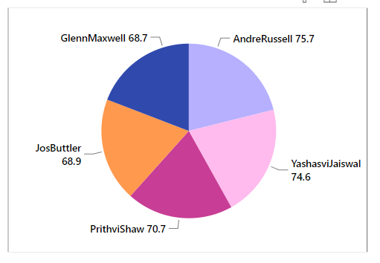
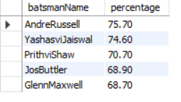
Ques.7 Top 5 batsmen based on past 3 years boundary % ?

Slide 9
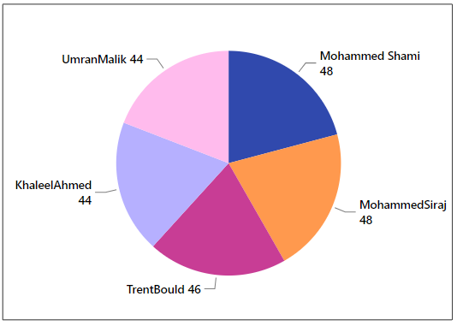
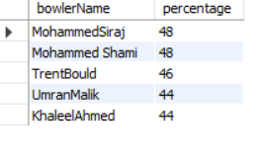
Ques.8 Top 5 bowlers based on past 3 years dot ball %.?

Slide 10
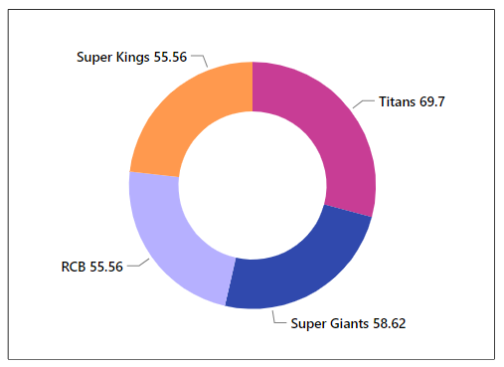
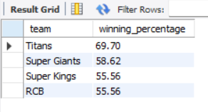
Ques.9 Top 4 teams based on past 3 years winning %?

Slide 11
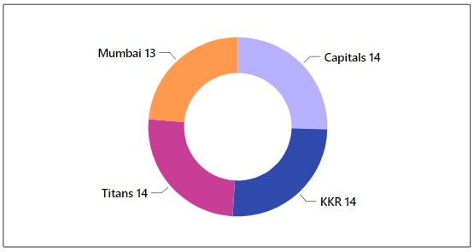
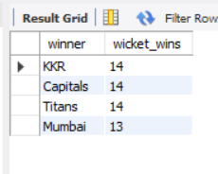
Ques.10 Top 2 teams with the highest number of wins achieved by chasing targets over the past 3 years.?

Slide 12
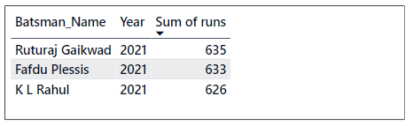
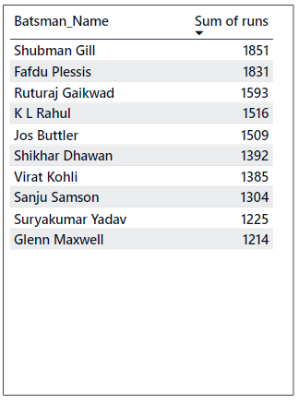
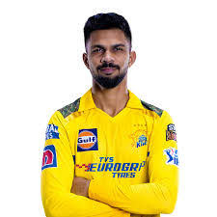
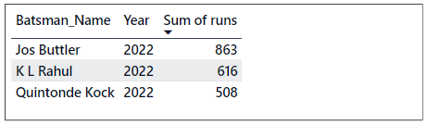
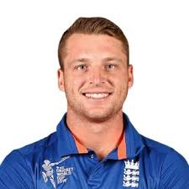
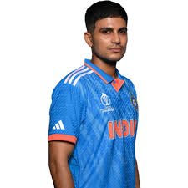
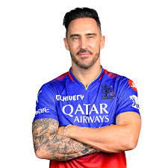
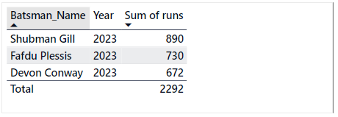
Orange cap player
"Top Run Scorer of 2021: Ruturaj Gaikwad“
"Top Run Scorer of 2022: Joss Buttler“
"Top Run Scorer of 2023: Shubham Gill“
"Top Run Scorer of the Last Three Seasons: Shubman Gill
followed by Fafdu Plessis"

Slide 13
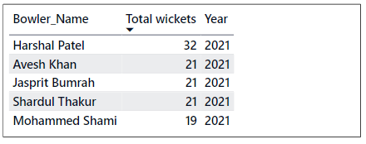
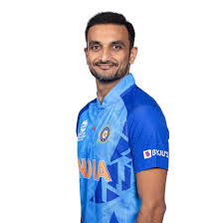
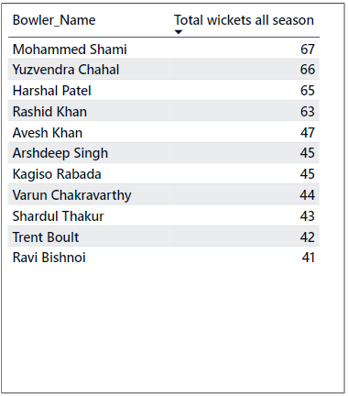
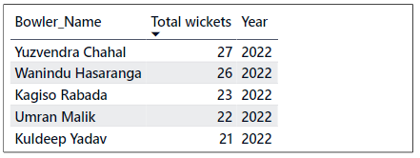
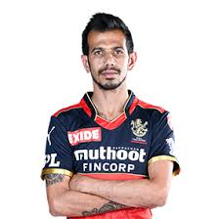
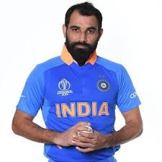
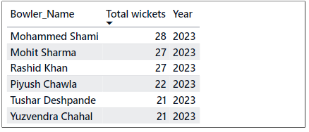
Purple cap player
"Leading Wicket Taker in 2021: Harshal Patel”
"Leading Wicket Taker in 2022: Yuzvendra Chahal”
"Leading Wicket Taker in 2023: Mohammed Shami”
Leading Wicket Taker of the Last Three Seasons: Mohammed Shami followed by Yuzvendra Chahal”

